Slide 1

Learning Platform for Institutions
-L.Sridhar Yadav 22STUCHH010684
SEC-E
UNDER THE GUIDANCE
Mr. Kaleem Mohammad

Slide 2
LOGO
Introduction
CampusGenius is an AI-powered learning platform designed for colleges and students.
It offers a centralized system for quizzes, meetings, notes sharing, summarization, and doubt solving.
The platform has two modules: Faculty (Admins) and Students (Users).
The aim is to enhance communication, productivity, and learning outcomes for both students and teachers.
Ensures real-time collaboration and personalized learning experiences.

Slide 3
Problem Statement
Traditional learning platforms often lack real-time interaction, personalized AI support, and effective faculty-student collaboration.
There are no platform that AI-integrated platform that supports learning, note-sharing, meeting summarization, and quiz generation in one place
Many e-learning platforms like Moodle and Google Classroom provide basic LMS features but lack AI integration.
Existing systems are often not user-friendly or do not combine all features (chatbot, notes, quizzes, meetings) in one unified interface

Slide 4
Project Objective
Create a smart learning platform for colleges and universities.
Bring quizzes, meetings, notes, and doubt-solving into one system.
Use AI to make quizzes, summarize notes, and answer questions faster.
Help students learn better with instant support and easy access to materials.
Improve real-time communication between students and teachers.
Make it easy for faculty to manage classes, meetings, and track student performance.

Slide 5
Key Features
Quizzes: Faculty can create quizzes; students can take them.
Meetings: Real-time video meetings with participant control.
Summarization: Summarize meetings or texts using AI.
Notes Sharing: Upload and access study material easily.
Chatbot: AI-powered assistant for Q&A, quiz generation, and more.

Slide 6
User Modules
Faculty :
  Create quizzes, meetings, and add notes.
  View student performance.
  Use AI tools for automation.
Students :
  Join meetings, take quizzes.
  View notes, use AI chatbot.
  Get performance insights

Slide 7
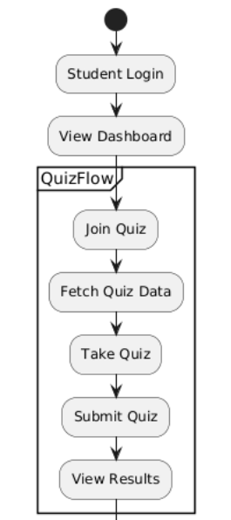
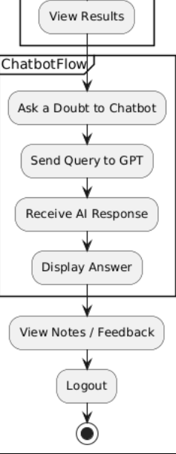
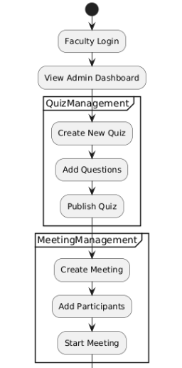
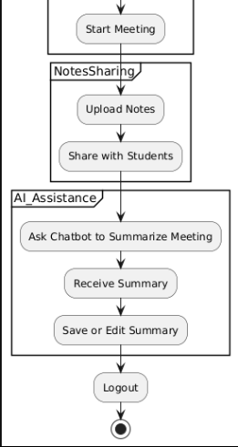
System Architecture
1)student
2) Faculty

Slide 8
Tech Stack
Frontend: Next.js, Tailwind CSS, Redux
Backend: Django, FastAPI
Database:
  Prisma ORM (Database management),
  MySQL (structured),
  MongoDB (unstructured)
Real-Time: Socket.io, WebRTC
AI: Groq GPT API, LangChain
Authentication: JWT, OAuth 2.0, Django Allauth

Slide 9
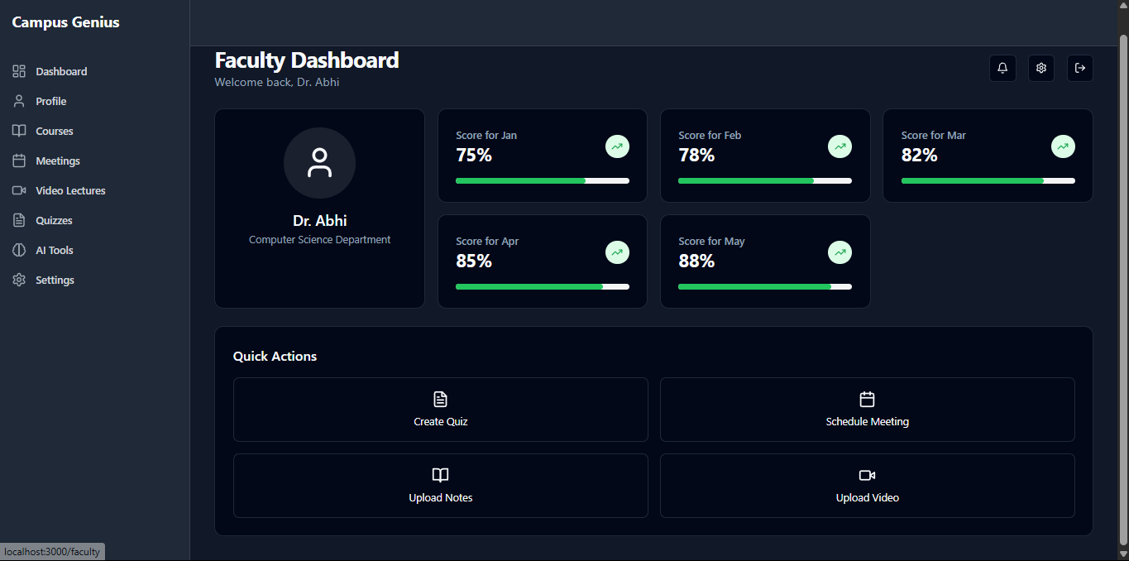
UI Screens
1) Faculty Dashbord

Slide 10
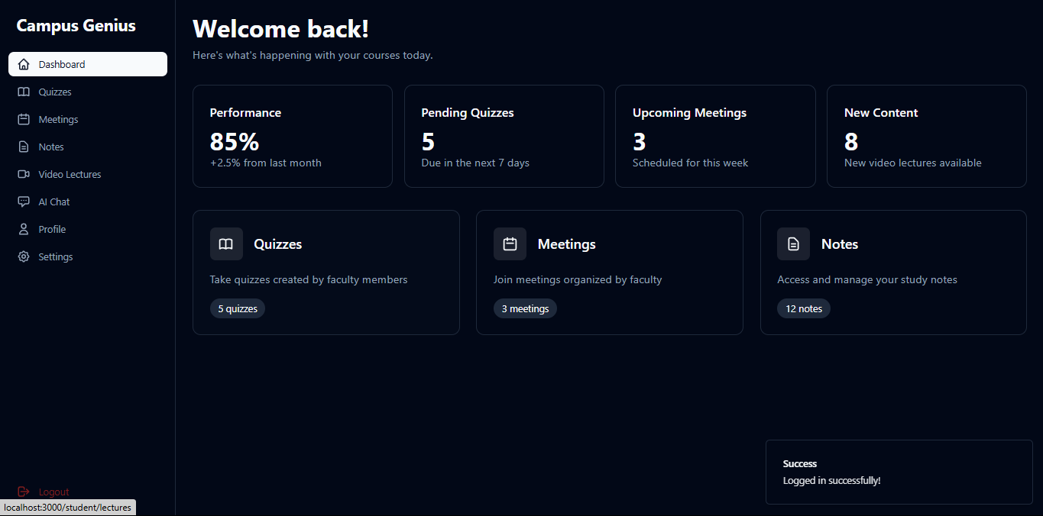
2) Student Dashboard

Slide 11
Future Scope
Adaptive Learning Paths
Mobile App Development
Voice Assistant Integration
Faculty Collaboration Tools
Multilingual Support

Slide 12
Conclusion
CampusGenius provides a smart, centralized platform for students and faculty to engage in learning through quizzes, meetings, and note sharing.
The integration of AI features like summarization and chatbot assistance enhances the learning and teaching experience.
Using modern technologies (Next.js, FastAPI, Prisma, GPT) improves scalability, responsiveness, and performance.
The platform is designed to user-friendly, secure, and adaptable for different educational needs.

Slide 13
THANK YOU
.

